Slide 1
Pointers in C

Slide 2
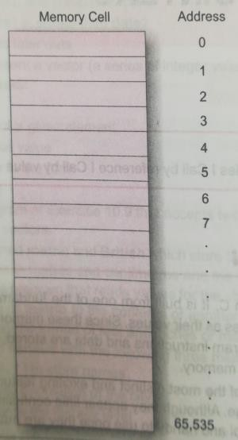
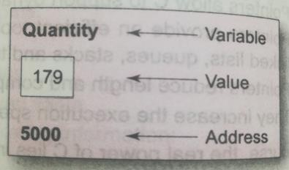
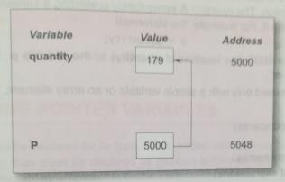
Memory Organizations and Variable Representations

Slide 3
Pointers in C
A pointer is a variable whose value is the address of another variable, i.e., direct address of the memory location.
Reference operator (&) - gives you the address of a variable
Dereference operator (*) - gets you the value from the address
Accessing the address of the variable
p = &a; // will assign the address of the variable a to p
if x is an array, then the expressions &x[0] or &x[i+3] are valid
Some illegal usage: | &125; | //point to constants
 | int x[10]; &x; | //pointing to array names
 | &(x+y) | //pointing at expressions

Slide 4
Declaring pointer variables
Syntax: data_type *pointer_variable_name;
int *p;
Example:
int *ip;
/* pointer to an integer */
/* pointer to a double */
/* pointer to a float */
/* pointer to a character */
double *dp; float *fp;
char *ch

Slide 5
Pointers in C
#include <stdio.h> int main()
{
int var = 5;
printf("Value: %d\n", var); printf("Address: %u", &var); return 0;
}
Output: Value: 5
Address: 2686778

Slide 6
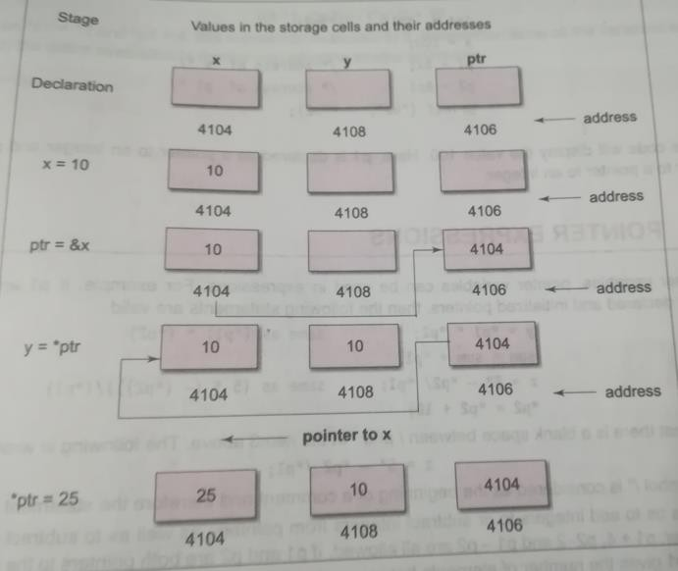
Pointer Assignments

Slide 7
How Pointer Works?
#include <stdio.h>
int main()
{
int* pc, c; c = 22;
printf("Address of c: %u\n", &c); printf("Value of c: %d\n\n", c);
OUTPUT
Address of c: 2686784 Value of c: 22
Address of pointer pc: 2686784
Content of pointer pc: 22
Address of c: 2686784 Value of c: 2
pc = &c;
printf("Address of pointer pc: %u\n", pc); printf("Content of pointer pc: %d\n\n", *pc);
*pc = 2;
printf("Address of c: %u\n", &c); printf("Value of c: %d\n\n", c); return 0; }
7

Slide 8
Pointer Analysis – Say Correct or Wrong
int c, *pc;
pc = c;
// Wrong! pc is address whereas, c is not an address.
*pc = &c;
// Wrong! *pc is the value pointed by address
pc = &c;
// Correct! pc is an address and, %amp;pc is also an address.
*pc = c;
// Correct! *pc is the value pointed by address and, c is also a value.

Slide 9
NULL Pointers
It is always a good practice to assign a NULL value to a pointer variable in case you do not have an exact address to be assigned.
#include <stdio.h> int main () {
int *ptr = NULL;
printf("The value of ptr is : %x\n", ptr );
return 0;
}
To check for a null pointer, you can use an 'if' statement as follows −
if(ptr) if(!ptr)
/* succeeds if p is not null */
/* succeeds if p is null */
Note: Except NULL and 0, no other value can be assigned to pointer

Slide 10
Pointer Arithmetic
A limited set of arithmetic operations can be performed on pointers. A pointer may be:
incremented ( ++ )
decremented ( -- )
an integer may be added to a pointer ( + or += )
an integer may be subtracted from a pointer ( – or -= )
10

Slide 11
Example
#include <stdio.h> const int MAX = 3;
OUTPUT
Address of var[0] = bf882b30 Value of var[0] = 10
Address of var[1] = bf882b34 Value of var[1] = 100 Address of var[2] = bf882b38 Value of var[2] = 200
int main ()
{
int var[] = {10, 100, 200};
int i, *ptr;
ptr = var;
for ( i = 0; i < MAX; i++) {
printf("Address of var[%d] = %x\n", i, ptr ); printf("Value of var[%d] = %d\n", i, *ptr );
ptr++;
}
return 0;
}

Slide 12

Chain of Pointers
main()
{
int x, *p1, **p2; x = 100;
p1 = &x; p2 = &p1;
printf(“%d”, **p2);
}
OUTPUT: 100
12

